Slide 1
Review Guide
Environment Diagrams
Sunday, July 9th
Environment Diagram Rules
Box-and-Pointer Overview
(Optional) Walk Through
(Extra) Personal “book keeping”/organization tips!

Slide 2
Environment Diagram Rules

Slide 3
The Four Rules to Remember
If you rigorously stick to these four rules and practice a lot, you’ll be able to get past most tricks in environment diagrams!
How to perform lookup
Evaluating a primitive expression
Evaluating a call expression
What is the parent frame of a function?

Slide 4
Performing Lookup

Slide 5
Definition & Procedure: Lookup
What is lookup?
Think of a physical dictionary
You want to look-up the value of an unknown name
What is the process of lookup?
Check in the current frame
Move to your parent frame
Continue until you hit the global frame
If you still haven’t found it --> NameError
Notes:
Python is unlike some other programming languages (doesn’t have a type assigned to a variable name)
Can’t tell if “add” is a assigned to a function or a primitive value (i.e. int), so it must look up the value of “add” to use.
for humans, it’s intuitive to look at a name and identify it as a function or a string or etc.
however, when python looks through your code, it needs to take in every single line of your code and evaluate what exactly is going on
when it comes across a name/variable, it doesn’t know what it contains, such it must look-up what the value of this name/variable is

Slide 6
Primitive vs. Call Expressions

Slide 7
Primitive Expressions
Call Expressions
single step evaluation
includes names, and primitive types (i.e. ints, strings)
can be in the following forms:
Names: x, square, print
Literals: 4, 3.4, ‘zam’
a function call
has an operator and operand(s)
can be in the following forms:
g(4)
2 + 3
(lambda x: x*x)(2)

Slide 8
Evaluating Primitive Expressions

Slide 9
1-step process...
Perform look-up!
primitive expr = names, literals
...for a 1-step evaluation

Slide 10
Quick Review

Slide 11
Take 30 secs to do this!
ID: Call vs. Primitive expr
>>> import add from operator
>>> add
>>> add(2, 3)
>>> def square(x):
return x * x
>>> square
>>> x = square(2)
>>> x

Slide 12
Take 30 secs to do this!
ID: Call vs. Primitive expr
>>> import add from operator
>>> add
>>> add(2, 3)
>>> def square(x):
return x * x
>>> square
>>> x = square(2)
>>> x
<built-in function add>
5
<function square at 0x1021789d8>
4
add is a primitive expr
add(2,3) is a call expr
square is a primitive expr
square(2) is a call expr
x is a primitive expr
note: it is sufficient to just write “Function” for add, square.

Slide 13
Evaluating Call Expressions

Slide 14
Evaluating Call Expressions

Slide 15
Call Expressions (aka function call)
Evaluate Operator
Evaluate Operand
Apply Operator --> Operand
multi-step evaluations.
the !! golden !! trio!!

Slide 16
(1) Evaluate Operator
ID: What is the operator?
>>> add(2,3)
5
>>> 3 + 4
7
>>> print(2)
>>> make_adder(2)(3)
5
usually is a primitive expr
if it is a primitive expr, how do you evaluate the operator?
perform look-up.
how about in the case of HOF?
Notes:
Eval Operator:
is usually a primitive expr because it’s a name that’s bound to a function definition somewhere
but can be more elaborate -- i.e. HOF
Eval Operand
can be anything
a primitive expr, a function definition, another call expr

Slide 17
(1) Evaluate Operator
ID: What is the operator?
>>> add(2,3)
5
>>> 3 + 4
7
>>> print(2)
>>> make_adder(2)(3)
5
usually is a primitive expr
if it is a primitive expr, how do you evaluate the operator?
perform look-up.
how about in the case of HOF?
Notes:
Eval Operator:
is usually a primitive expr because it’s a name that’s bound to a function definition somewhere
but can be more elaborate -- i.e. HOF
Eval Operand
can be anything
a primitive expr, a function definition, another call expr

Slide 18
(2) Evaluate Operand
ID: What is the operand(s)?
>>> sub(2, 3)
-1
>>> square(square(2))
16
>>> mystery(lambda x: x*x)
if primitive expr: lookup
if call expr: repeat from the top
if lambda expr: function definition!
this step is recursive in nature — do you see why?
Notes:
Eval Operator:
is usually a primitive expr because it’s a name that’s bound to a function definition somewhere
but can be more elaborate -- i.e. HOF
Eval Operand
can be anything
a primitive expr, a function definition, another call expr

Slide 19
(2) Evaluate Operand
ID: What is the operand(s)?
>>> sub(2, 3)
-1
>>> square(square(2))
16
>>> mystery(lambda x: x*x)
if primitive expr: lookup
if call expr: repeat from the top
if lambda expr: function definition!
this step is recursive in nature — do you see why?
Notes:
Eval Operator:
is usually a primitive expr because it’s a name that’s bound to a function definition somewhere
but can be more elaborate -- i.e. HOF
Eval Operand
can be anything
a primitive expr, a function definition, another call expr

Slide 20
(3) Apply Operator > Operand
you can finally open/create a new frame!
user-defined functions only!
set up your frame using info from steps 1 & 2
frame structure is intrinsic function’s info
param value is passed-in from: step 2, eval operand
continue to evaluate the body of the function, line by line
aka: making a “function call”
Notes:
Eval Operator:
is usually a primitive expr because it’s a name that’s bound to a function definition somewhere
but can be more elaborate -- i.e. HOF
Eval Operand
can be anything
a primitive expr, a function definition, another call expr
Apply Operator > Operand
frame #, intrinsic name, and formal parameter name should be taken from the function definition you drew in your env diagram
technically at this point you shouldn’t be looking back at your code, because it’s easy to get confused
just go with what you know is for certain in the env diagram!

Slide 21
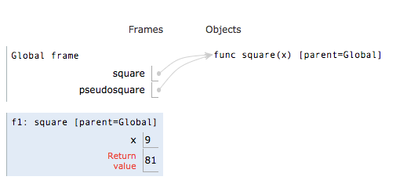
Always remember to include the 4 key pieces of information when setting up a new frame:
frame number
func’s intrinsic name
func’s parent frame
formal parameters
fill out the formal parameter w/the values you obtained from evaluating the operands earlier
>>> def square(x):
return x*x
>>> pseudosquare = square
>>> pseudosquare(4 + 5)
https://goo.gl/wgc99v
Notes:
Eval Operator:
is usually a primitive expr because it’s a name that’s bound to a function definition somewhere
but can be more elaborate -- i.e. HOF
Eval Operand
can be anything
a primitive expr, a function definition, another call expr
Apply Operator > Operand
frame #, intrinsic name, and formal parameter name should be taken from the function definition you drew in your env diagram
technically at this point you shouldn’t be looking back at your code, because it’s easy to get confused
just go with what you know is for certain in the env diagram!

Slide 22
which frame is opened first?
>>> what(is(going(on(42)))))
>>> good(luck)(on)(ur)(MT)(1)
>>> (lambda m: lambda z: lambda a: a * z)(2)(4)(5)
Notes:
Eval Operator:
is usually a primitive expr because it’s a name that’s bound to a function definition somewhere
but can be more elaborate -- i.e. HOF
Eval Operand
can be anything
a primitive expr, a function definition, another call expr
Apply Operator > Operand
frame #, intrinsic name, and formal parameter name should be taken from the function definition you drew in your env diagram
technically at this point you shouldn’t be looking back at your code, because it’s easy to get confused
just go with what you know is for certain in the env diagram!

Slide 23
which frame is opened first?
>>> what(is(going(on(42)))))
>>> good(luck)(on)(ur)(MT)(1)
>>> (lambda m: lambda z: lambda a: a * z)(2)(4)(5)
you can choose to remember it with brute force, as generally:
nested call expressions: frames start inside out
higher order functions: frames start left to right
but remember the reason why is because of the 3 rules we’re going over right now!
eval operator
eval operand
apply
Notes:
Eval Operator:
is usually a primitive expr because it’s a name that’s bound to a function definition somewhere
but can be more elaborate -- i.e. HOF
Eval Operand
can be anything
a primitive expr, a function definition, another call expr
Apply Operator > Operand
frame #, intrinsic name, and formal parameter name should be taken from the function definition you drew in your env diagram
technically at this point you shouldn’t be looking back at your code, because it’s easy to get confused
just go with what you know is for certain in the env diagram!

Slide 24
Parent Frame of a Function

Slide 25
Parent frame of a function is where the function is ______________?

Slide 26
Parent frame of a function is where the function is defined!
Notes:
plays the biggest role where lambda is concerned
though it can possibly trip people up elsewhere as well (but less likely)

Slide 27
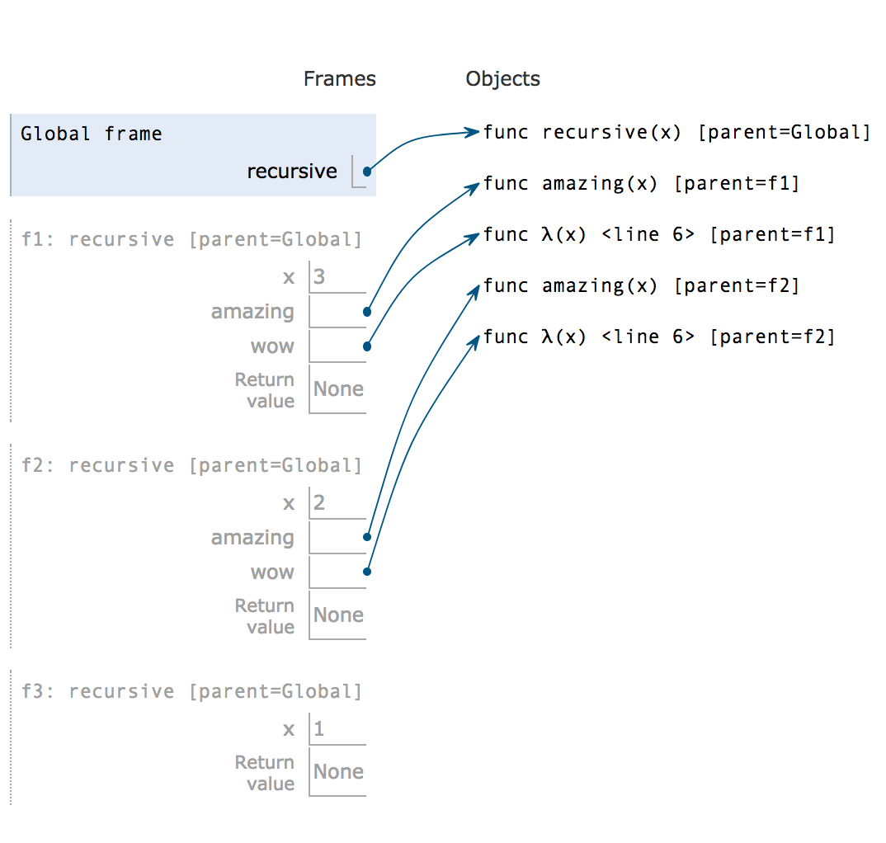
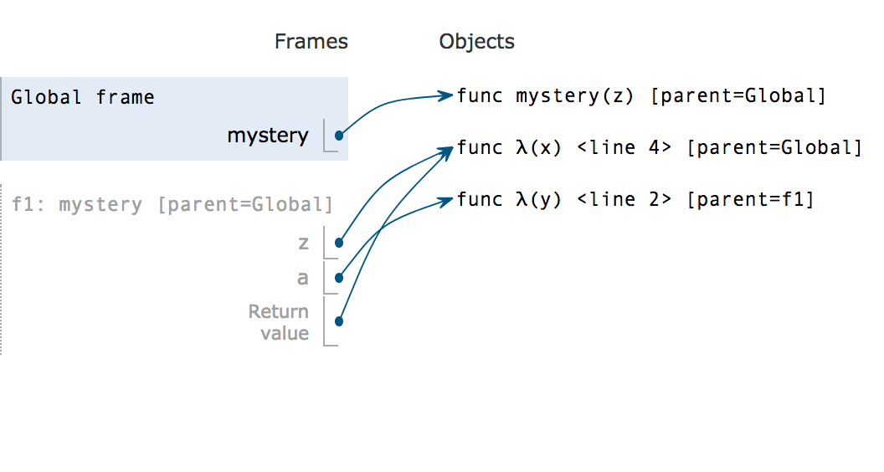
what are the parent frames?
>>> def recursive(x):
if x == 1:
return
def amazing(x):
return x
wow = lambda x: x
return recursive(x-1)
>>> recursive(3)
https://goo.gl/HD3XKq
>>> def mystery(z):
a = lambda y: y + z
return z
>>> mystery(lambda x: 2 + 1)
https://goo.gl/BcVDv6

Slide 28
A few more things to keep in mind!

Slide 29
Don’t forget that:
lambda functions are basically a def statement in disguise
therefore, evaluate lambdas as you would def statements!
calling a lambda expr looks like this: (lambda y: y + 2)(10)
defining a lambda expr looks like this: lambda y: y + 2
always evaluate operands from left to right
when evaluating assignment statements: (1) evaluate RIGHT SIDE first (2) then bind/assign the value to the left side ** this is why the following works: x = x + 4

Slide 30
(will be walking through an example at the very end!)

Slide 31
Box-and-Pointer Diagrams

Slide 32
Motivation
standard, visual way to represent certain data types (lists, tuples, linked lists, pairs, etc.)
helps you to keep track of the behavior of mutable objects
what’s the point!

Slide 33
how 2 draw these things
>>> basic = [1, 2, 3]
>>> nested = [61, [‘a’], ‘!’]
similar to function definitions, we use pointers to refer to list objects
name points to the list object
elements represented by adjacent boxes optional: label each box with the indice
(!) the arrow points to the object as a whole, not at a specific box!
1
2
3
basic
‘a’
61
‘!’
what do nested lists look like?
nested
A: “nested” pointer!!

Slide 34
more practice examples!!
quick example
>>> lst = [1, 2, 3]
>>> a = [1]
>>> a = lst
keep in mind that all evaluation rules still apply here!
you can think of the “value” of lst to be the pointer that leads it to the correct list object
how does this fact help you draw what “a” looks like?
https://goo.gl/cA9wxQ
>>> suits = ['heart', 'diamond', 'spade', 'club']
>>> lst = [2, 5, 6]
>>> lst = [[4], 5, [6, 7]]
>>> lst = [2, lst, 7]
https://goo.gl/oPoeqH

Slide 35
100%
ready to conquer / practice conquering environment diagrams!!??
(the correct answer is yes!!!!!! woo!!!!!!!)

Slide 36
Come to the front for an env diagram walkthrough!
we have two options ooOOoh spoopy
inside(out)
no “rst” for the Weary

Slide 37

gud luck and have fun :’)
also, book-keeping tips will be on the last few slides!

Slide 38
book-keeping
everyone has their own techniques & tricks to keep their env diagram organized — take what you want from these slides and adapt it according to your own preferences!
aka tips on how to organize env diagrams

Slide 39
(1) Whilst Opening a Frame
Things to take into consideration:
To set up the frame, technically you shouldn’t have to refer back to the code!
All the information you need to create the structure of your frame (intrinsic name, parent frame, formal param name, and operand value) is contained within the env diagram itself
Intrinsic name, parent frame, formal params are found by looking at the function found from step 1: eval operator
Avoid going back and forth between code and the diagram to mitigate name/value confusion
Basic Overview (again)
Label frame number i.e. F1
Fill out frame with: (1) the intrinsic function name (2) the function’s parent
Bind the function’s formal parameter(s) (if any) to the operands that you evaluated during step 1: eval operator

Slide 40
Visual Explanation
def field(trip): return trip + 1 run = field(4)
1. Evaluate operator/operands.
global
field
func field(trip) P: G
Notes:
Evaluate operator/operand
Open up a new frame to apply operator to operand
Follow steps listed above

Slide 41
Visual Explanation
def field(trip): return trip + 1 run = field(4)
1. Evaluate operator/operands.
global
field
func field(trip) P: G
Notes:
Evaluate operator/operand
Open up a new frame to apply operator to operand
Follow steps listed above

Slide 42
Visual Explanation
def field(trip): return trip + 1 run = field(4)
1. Evaluate operator/operands.
global
field
func field(trip) P: G
Notes:
Evaluate operator/operand
Open up a new frame to apply operator to operand
Follow steps listed above

Slide 43
Visual Explanation
def field(trip): return trip + 1 run = field(4)
1. Evaluate operator/operands.
2. Label frame number i.e. F1
global
field
func field(trip) P: G
F1:
Notes:
Evaluate operator/operand
Open up a new frame to apply operator to operand
Follow steps listed above

Slide 44
Visual Explanation
def field(trip): return trip + 1 run = field(4)
1. Evaluate operator/operands.
2. Label frame number i.e. F1
global
field
func field(trip) P: G
3. Fill out frame with: (1) the intrinsic function name
F1: field
P:G
(2) the function’s parent
trip
(3) the formal parameter
Notes:
Evaluate operator/operand
Open up a new frame to apply operator to operand
Follow steps listed above

Slide 45
Visual Explanation
def field(trip): return trip + 1 run = field(4)
1. Evaluate operator/operands.
2. Label frame number i.e. F1
global
field
func field(trip) P: G
3. Fill out frame with: (1) the intrinsic function name
F1: field
P:G
(2) the function’s parent
trip
4
(3) the formal parameter
4. Bind the function’s formal parameter(s) (if any) to the operands that you evaluated during step 1: eval operator
Notes:
Evaluate operator/operand
Open up a new frame to apply operator to operand
Follow steps listed above

Slide 46
(2) Keeping Track of Nested Calls
Reason why keeping track of nested calls can be helpful: (1) To remember why a particular frame is open (2) To easily see where that frame’s value returns to (3) To make checking your work less confusing
How to keep track?
Write the call expression next to the frame or return box
Draw arrows between frames to keep track of return values

Slide 47
(2) Writing the Call Expression Down
def field(trip): if trip == 1: return trip
return field(trip - 1) + 1 run = field(2)
“Annotate” the call expr while evaluating the operator/operand
global
field
func field(trip) P: G
Helps you keep track of what the return value is used for & where it goes
F1: field
P:G
trip
2
2
1
RV
2
field(trip - 1) + 1
func field(trip) P: G
2 - 1
F2: field
P:G
trip
1
RV
1
Notes:
annotating the call expression makes creating a new frame when you apply the operator to the operand easier (quickly see what the intrinsic name or argument is being passed in is)

Slide 48
(3) Too many Lambdas?
When defining lambda functions, write down the line number where the lambda function is found
Because lambdas are “anonymous” functions, helps you keep track of which lambda function is which, when all the parameters are the same
1
2
3
4
5
6
7
def inside(out): anger = lambda fear: fear(disgust) fear = lambda disgust: anger(out) disgust = 3 fear(5) fear, disgust = 2, 4 inside( lambda fear : fear + disgust)

